Slide 1
Final Exam Q1 & Q2
Tan bing shien WQD180104

Slide 2

Q1 Web Crawling
FIFA Player Data (https://sofifa.com/)
Scrapy to crawl data
scrapy crawl players_url (to crawl every available player profile url)
scrapy crawl players_stats (to crawl stats of player)

Slide 3
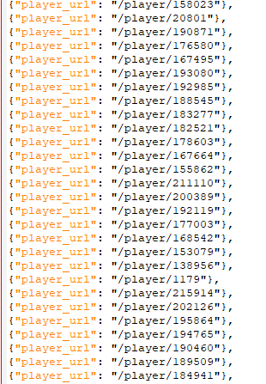
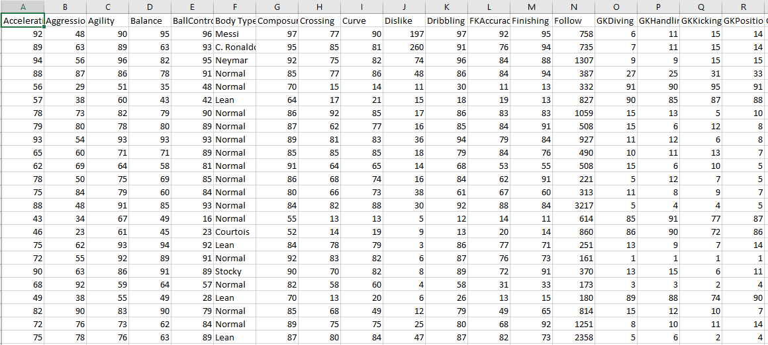
Web Crawling outputs
Player Stats
Player URLs

Slide 4
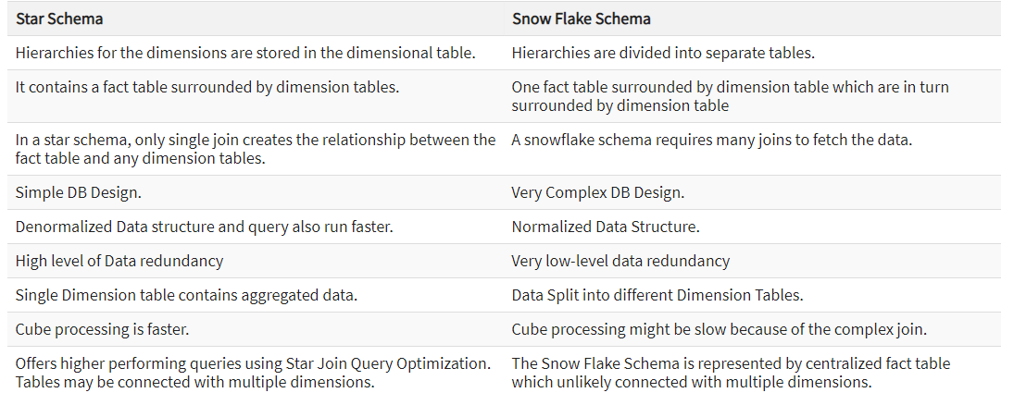
Q2 Snowflake diagram

Slide 5
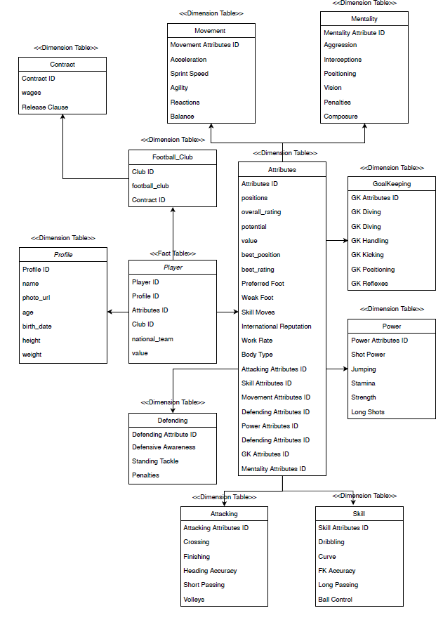
Snowflake Diagram

